Slide 1

OfferEdge
A Buyer-Initiated Reverse Bargaining Platform
Submitted by: Jefin Thomas Philip
TVE24MCA31

Slide 2

What is OfferEdge?
OfferEdge revolutionizes the traditional marketplace by empowering buyers. Instead of sellers setting prices, buyers initiate the process by posting their specific needs and desired terms. This creates a dynamic, competitive environment where sellers actively bid for the buyer's business, driving efficiency and value.

Slide 3


Addressing Marketplace Limitations
Traditional marketplaces often lead to price opacity and limited buyer influence. Buyers are forced to accept pre-determined prices, leading to a lack of transparency and competitive bidding. This often results in buyers paying more than necessary or settling for less ideal terms.
Current Marketplaces
Fixed prices, seller-driven, limited negotiation.
OfferEdge's Solution
Buyer-initiated, competitive bidding, real-time negotiation.

Slide 4







Key Modules
User Management
Requirement Posting
Quoting/Bidding
Negotiation
Deal Closure
Feedback and review
Reporting & Moderation

Slide 5







Detailed Module Breakdown
User Management
Requirement Posting
Manages secure registration, profile creation, and trust-building ratings for buyers and sellers.
Buyers detail specific needs, price range, and deadlines to attract targeted seller offers.
Quoting/Bidding
Negotiation
Sellers submit competitive, private offers with terms and attachments in response to buyer requirements.
Facilitates real-time counter-offers and refinement of deal terms with multiple sellers.
Deal Closure
Feedback & Review
Finalizes agreements, exchanges contact details, and collects post-deal feedback for trust building.
Give feedback and rating scores
Reporting & Moderation
Ensures platform integrity through user reporting and admin moderation to prevent fraud.

Slide 6

OfferEdge Use Case Diagram
This diagram illustrates the primary actors and their key interactions within the OfferEdge platform, highlighting the buyer-centric flow.
Buyer
Seller
Admin
Post Requirements
Browse Requirements
Manage Users
Review Bids
Submit Quotes
Monitor Activity
Negotiate Offers
Negotiate Terms
Accept Deal
Confirm Deal

Slide 7
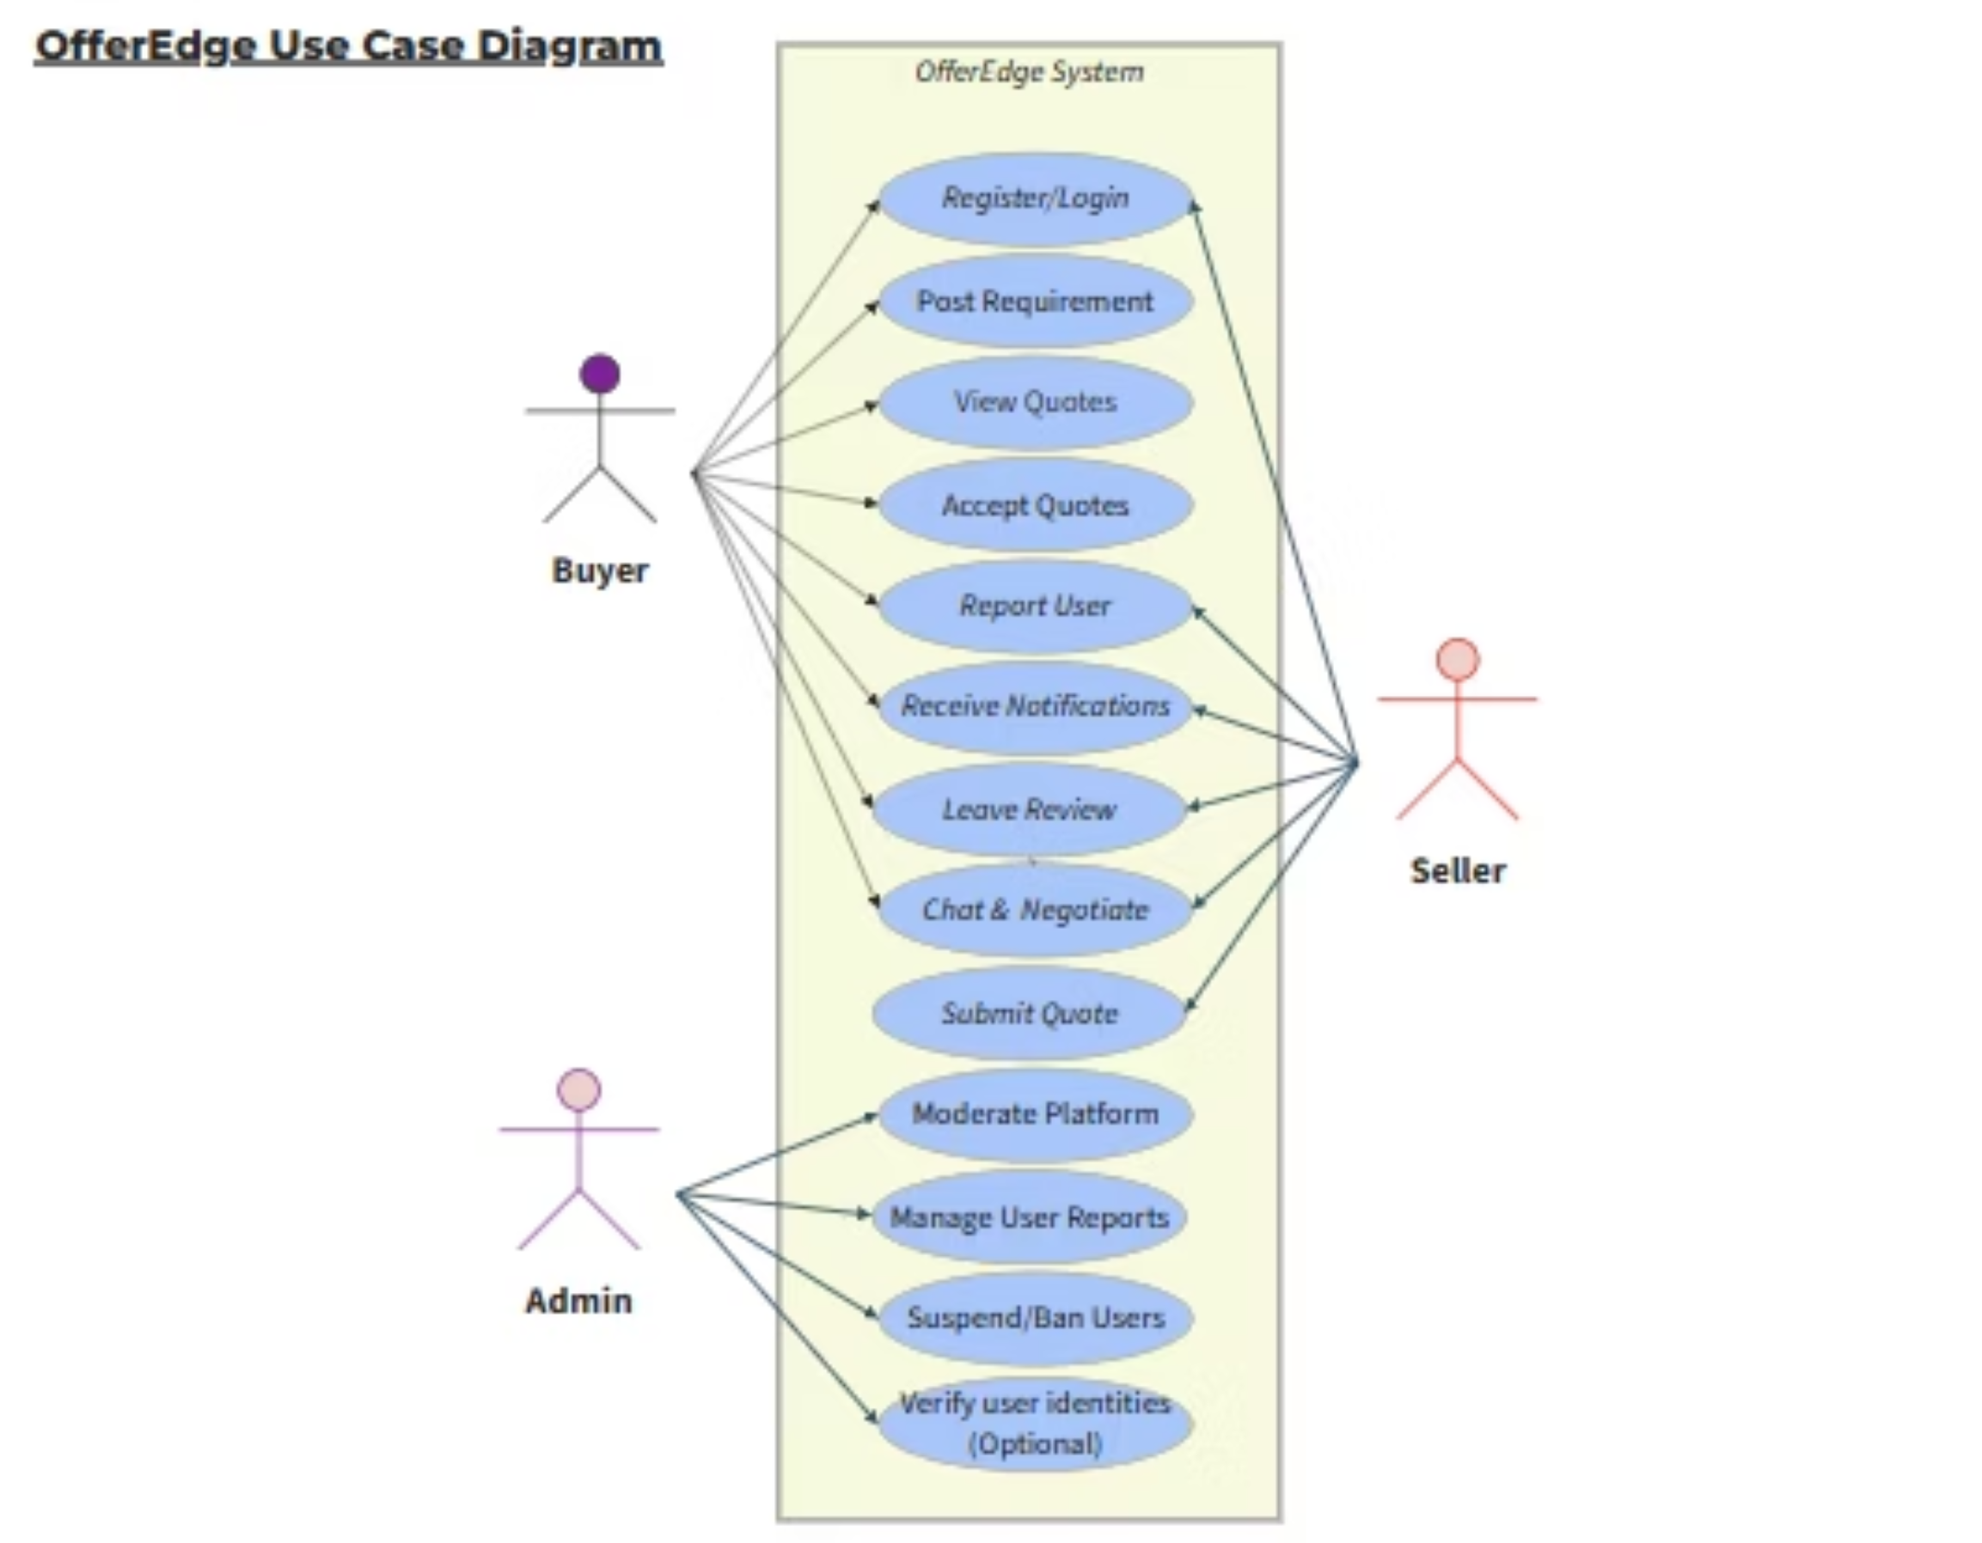

Slide 8
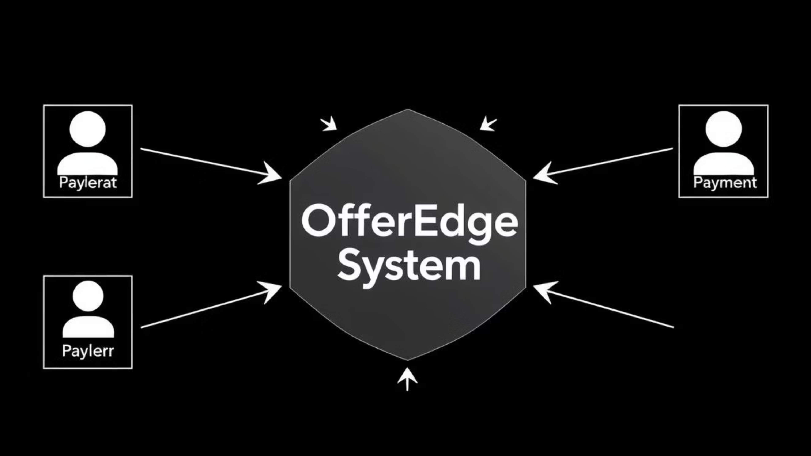
Data Flow Overview
Level 0
The OfferEdge system serves as the central hub, facilitating all interactions between buyers, sellers, admins.
Level 1: Core Process Flow
Buyer posts requirement to OfferEdge.
OfferEdge notifies relevant sellers.
Sellers submit quotes to OfferEdge.
OfferEdge presents quotes to buyer.
Buyer & Seller negotiate via OfferEdge.
Buyer accepts or rejects the offer.

Slide 9
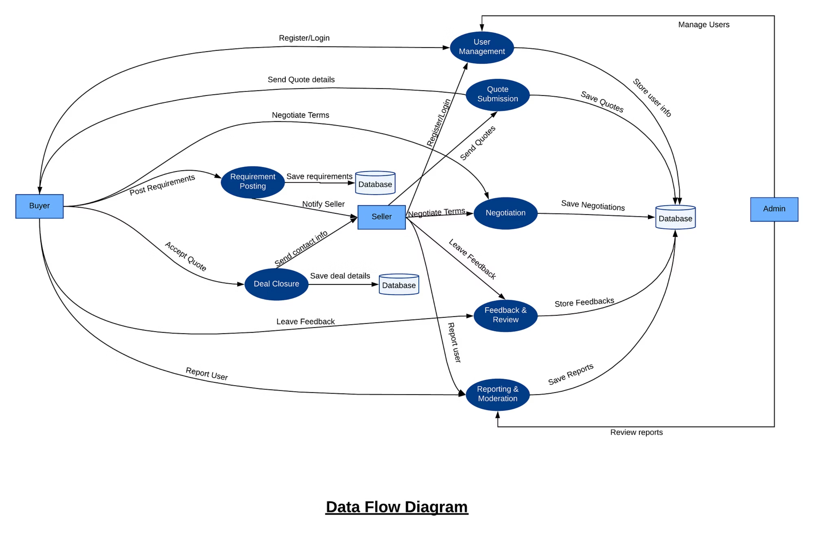

Slide 10
NoSQL Database Design
Leveraging a NoSQL database ensures flexibility, scalability, and high performance for handling diverse data structures.
Collection
Attributes (Key Features)
Users
_id,role,name,email,phone,passwordHash,ratings,createdAt
Requirements
_id, buyerId, title, description, quantity, expectedPriceRange, deadline, createdAt
Quotes
_id, reqId , sellerId, price, deliveryTimeline, notes,attachments, createdAt
Messages
_id,chatId,senderId,receiverId,message,attachments,Date
Deals
_id, reqId , buyerId , sellerId , Quoteid, createdAt
Reports
_id,reportedBy,reportedUser,dealId,reason,createdAt
Feedback
_id,dealId,fromUserId,toUserId,rating,review,createdAt

Slide 11
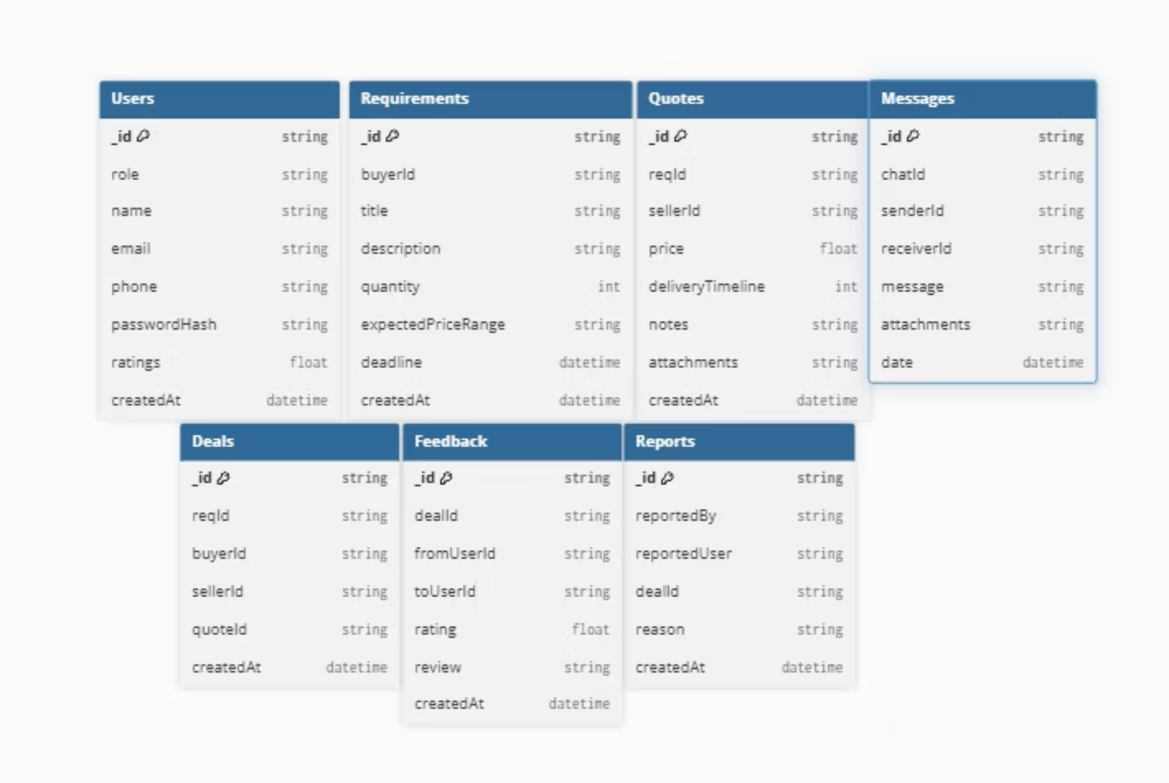

Slide 12
References
International Journal of Advanced Research in Science, Communication and Technology (IJARSCT)International Open-Access, Double-Blind, Peer-Reviewed, Refereed, Multidisciplinary Online Journal Volume 5, Issue 12 – April 2025 10.48175/IJARSCT-25956 402 2581-9429
Smart Reselling: Leveraging MERN Stack and AI for Intelligent Bidding in E-Commerce Swarnim Shekhar, Shrihari Chaurasiya, Prof. Deepa Mishra MIT-ADT University, Pune, Indiawww.ijarsct.co.in

Slide 13
User Interface for the Minimum Viable Product

Slide 14
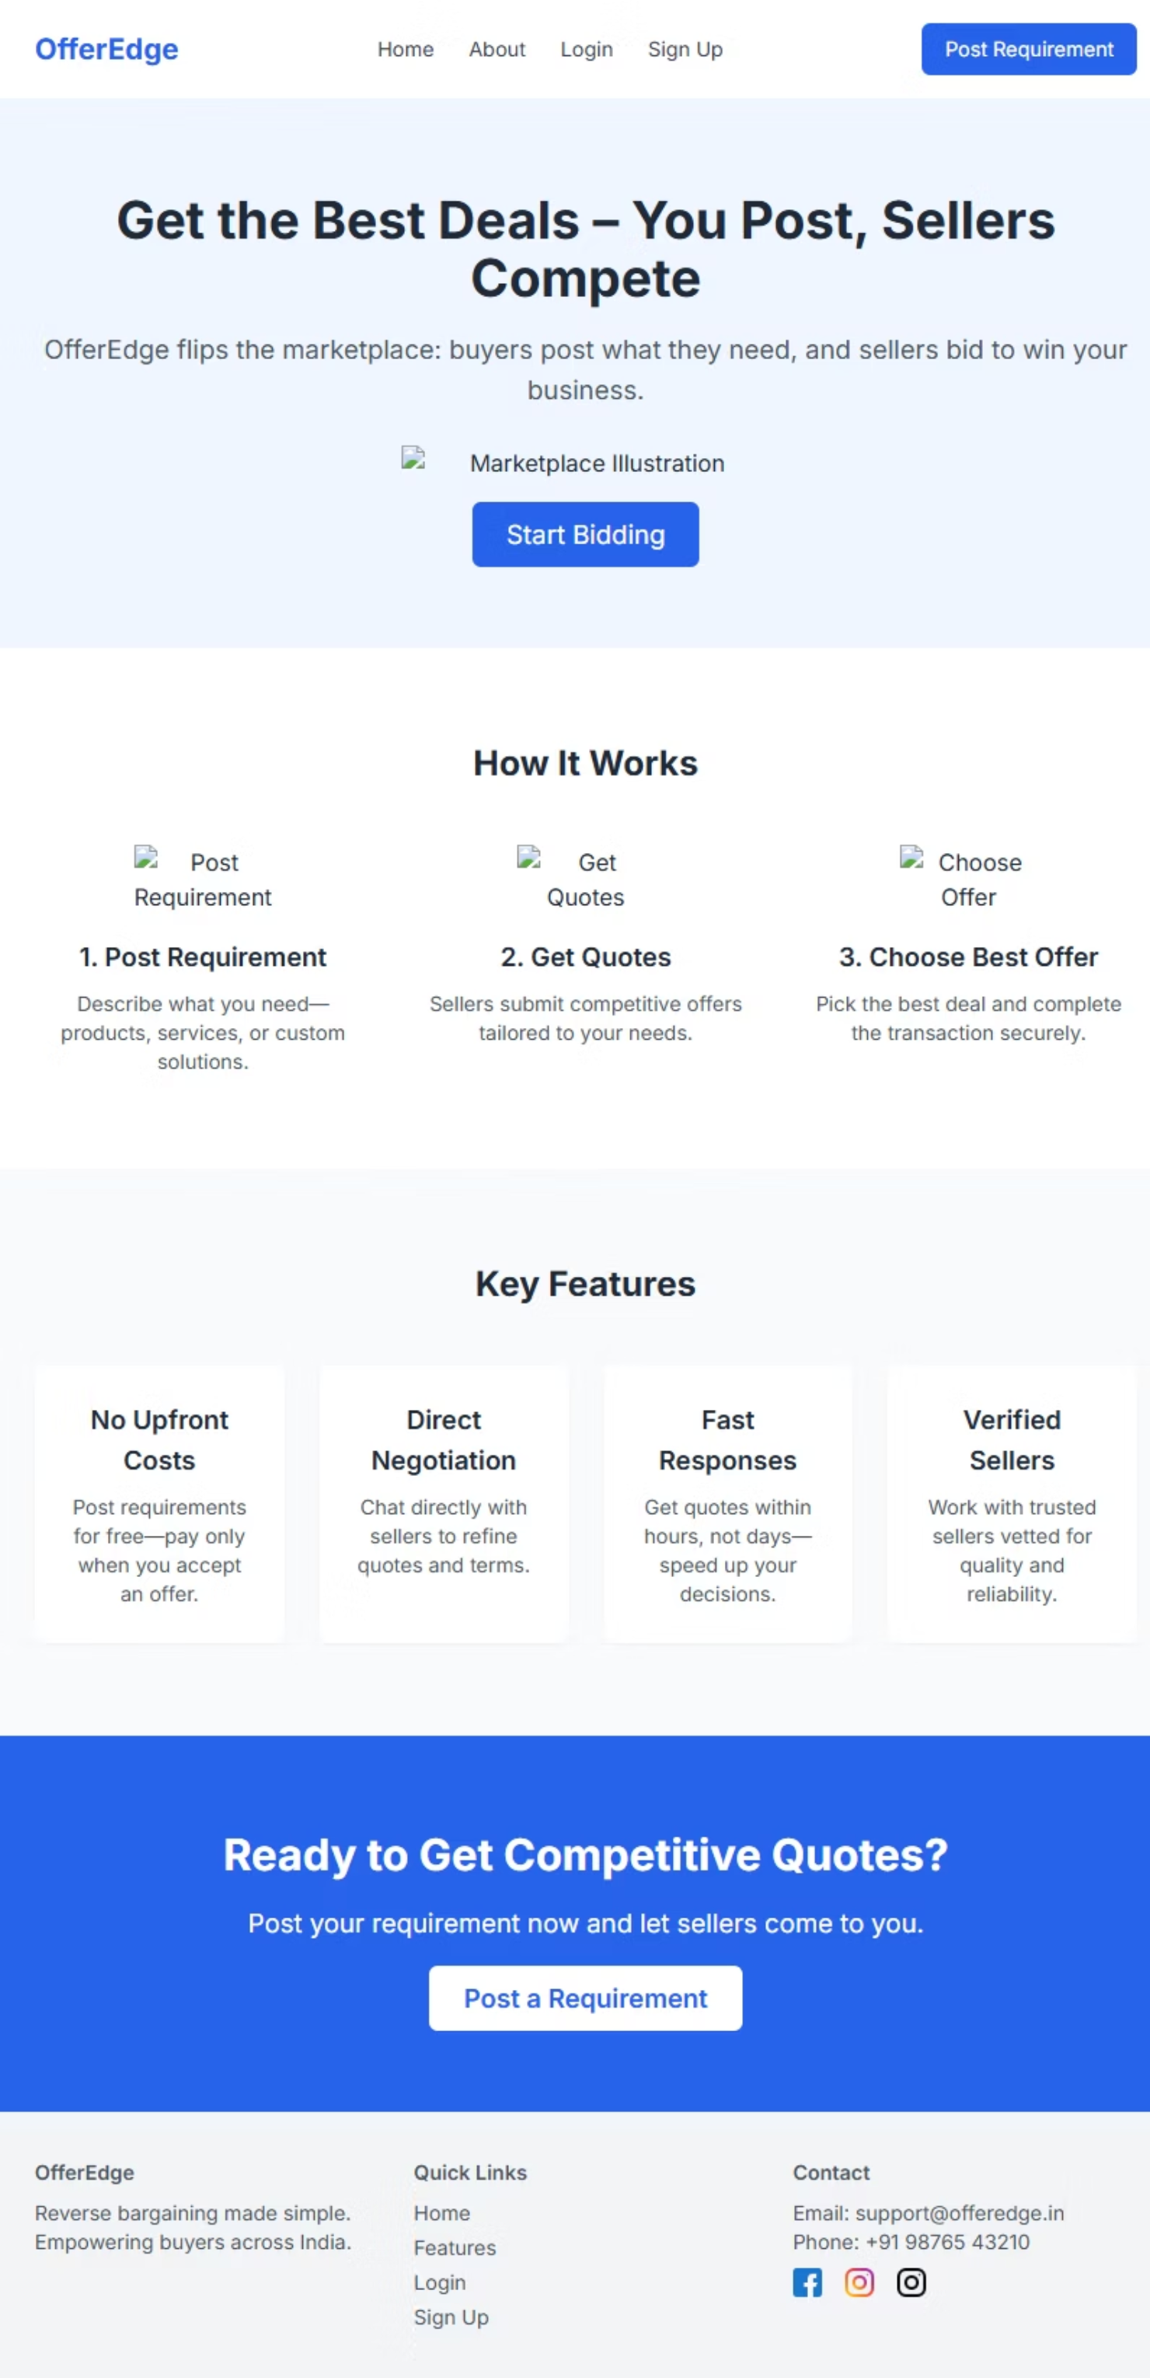

Slide 15
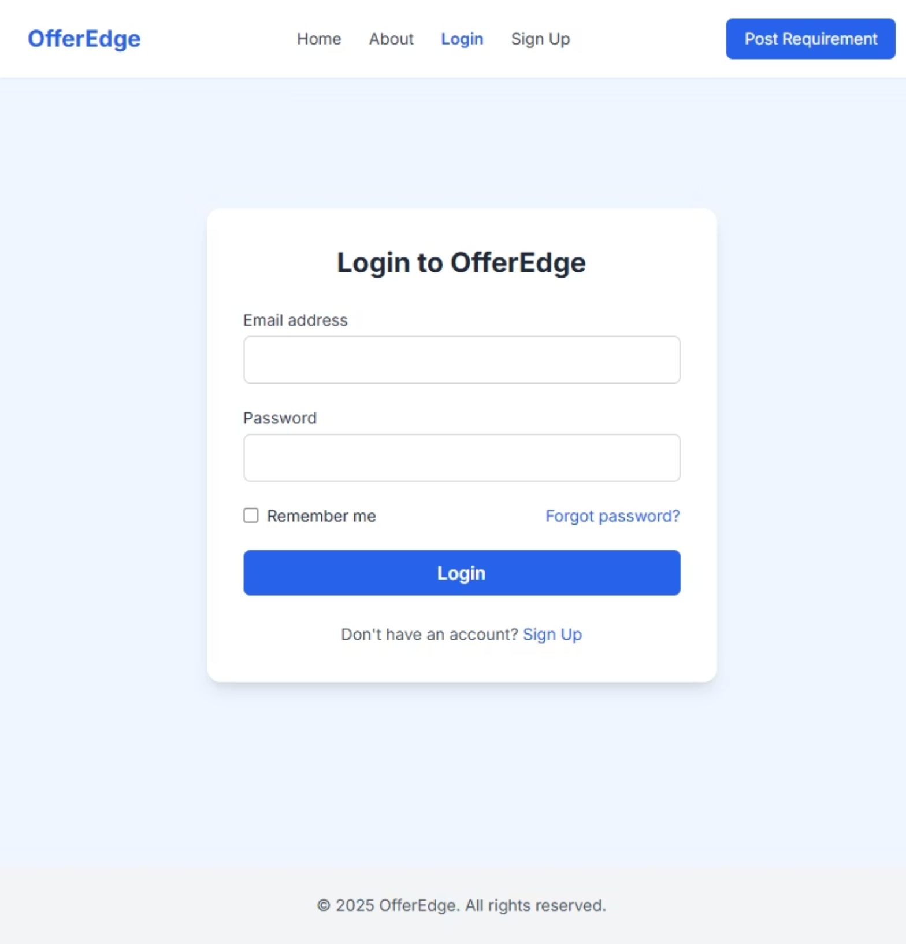
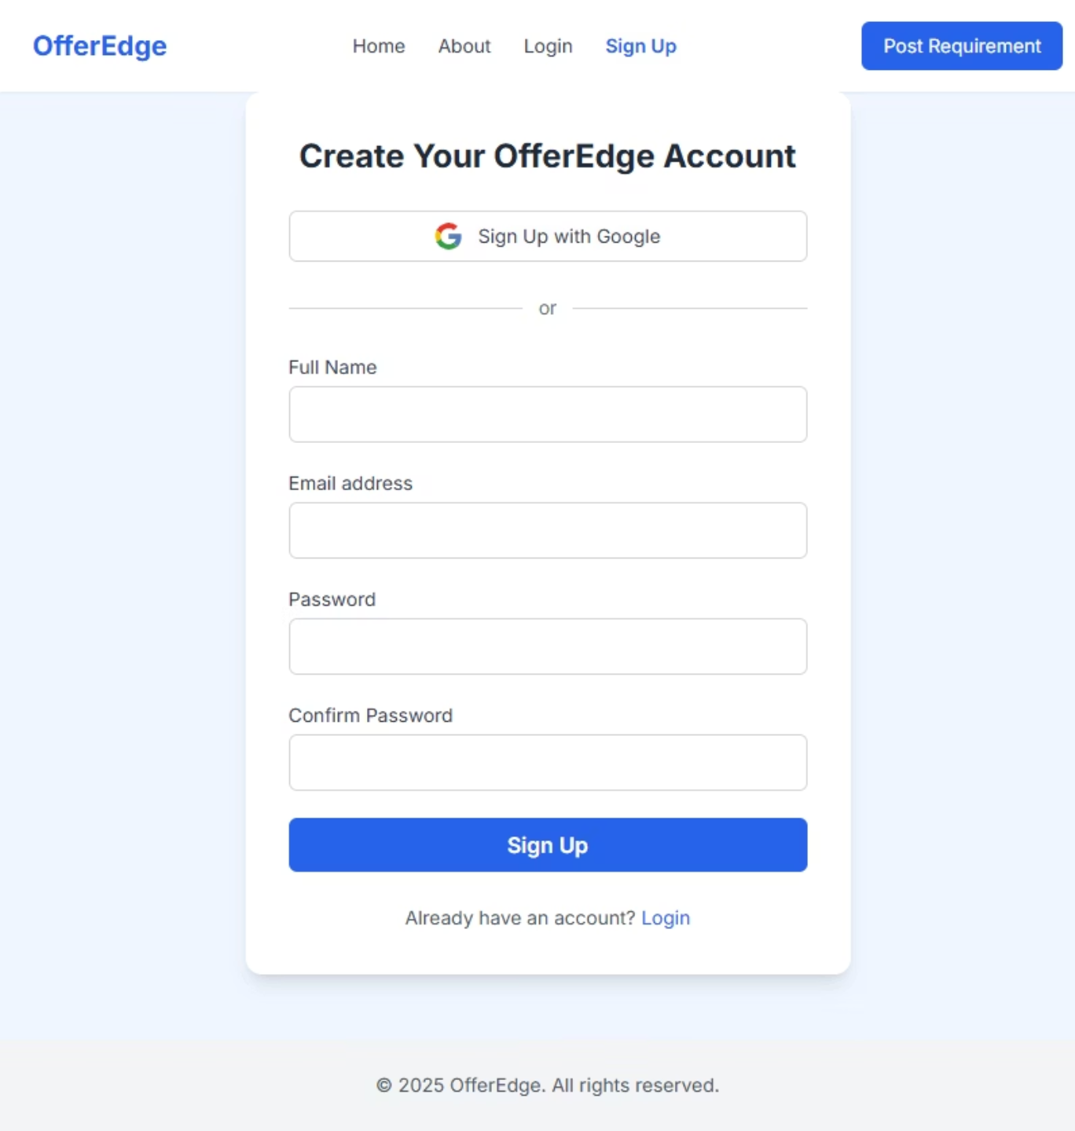

Slide 16
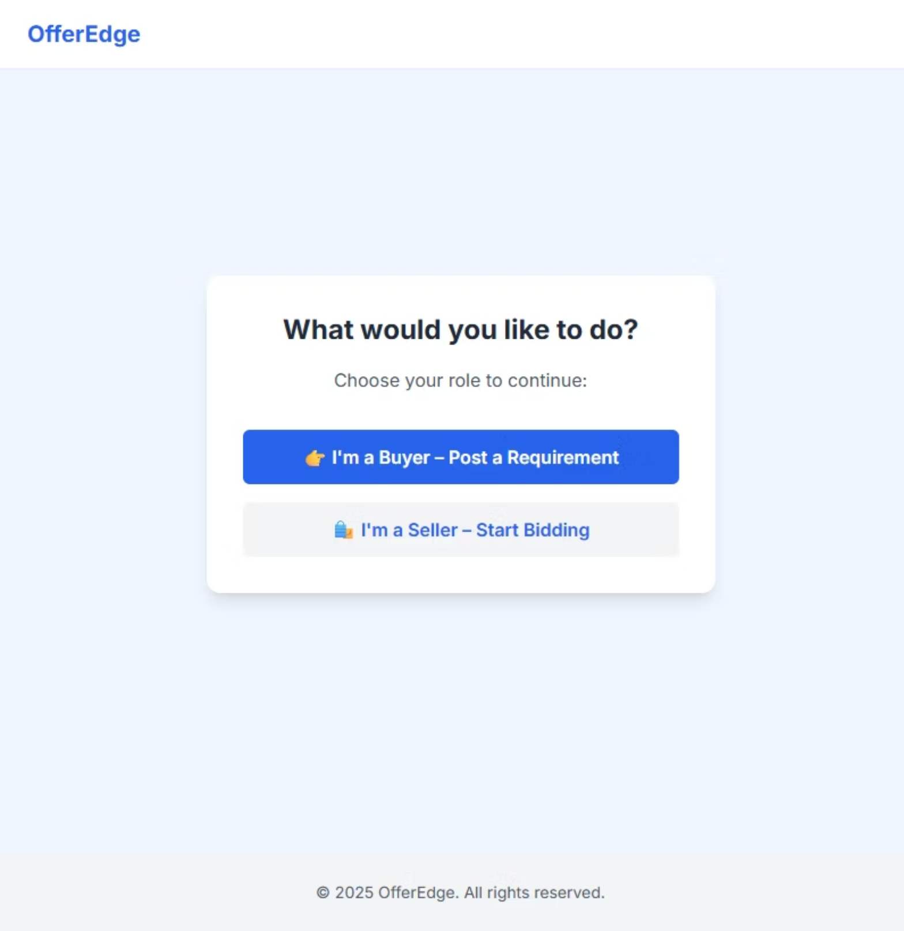

Slide 17
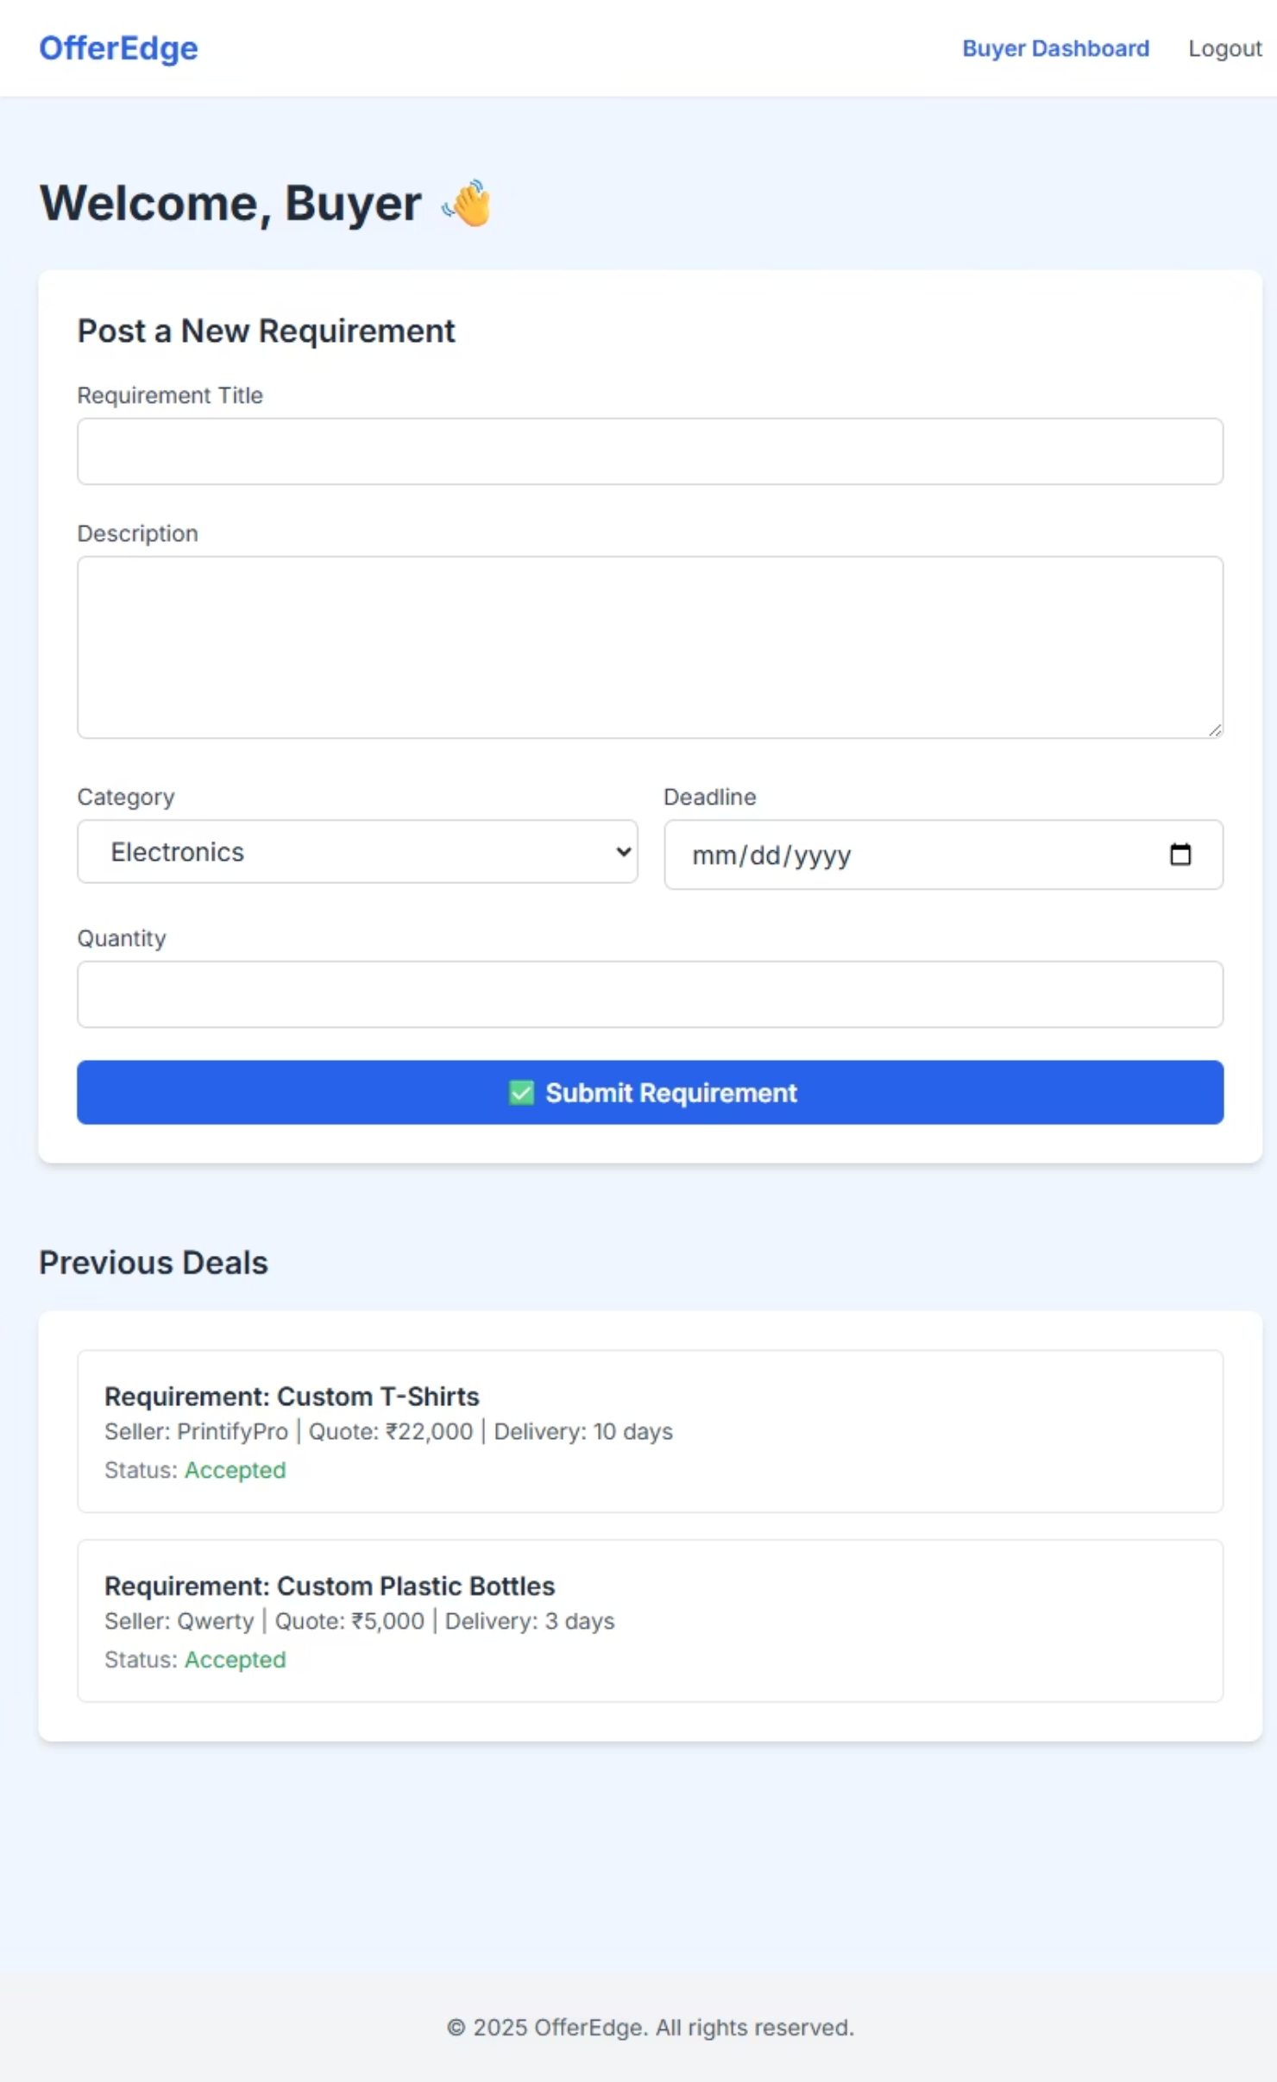

Slide 18
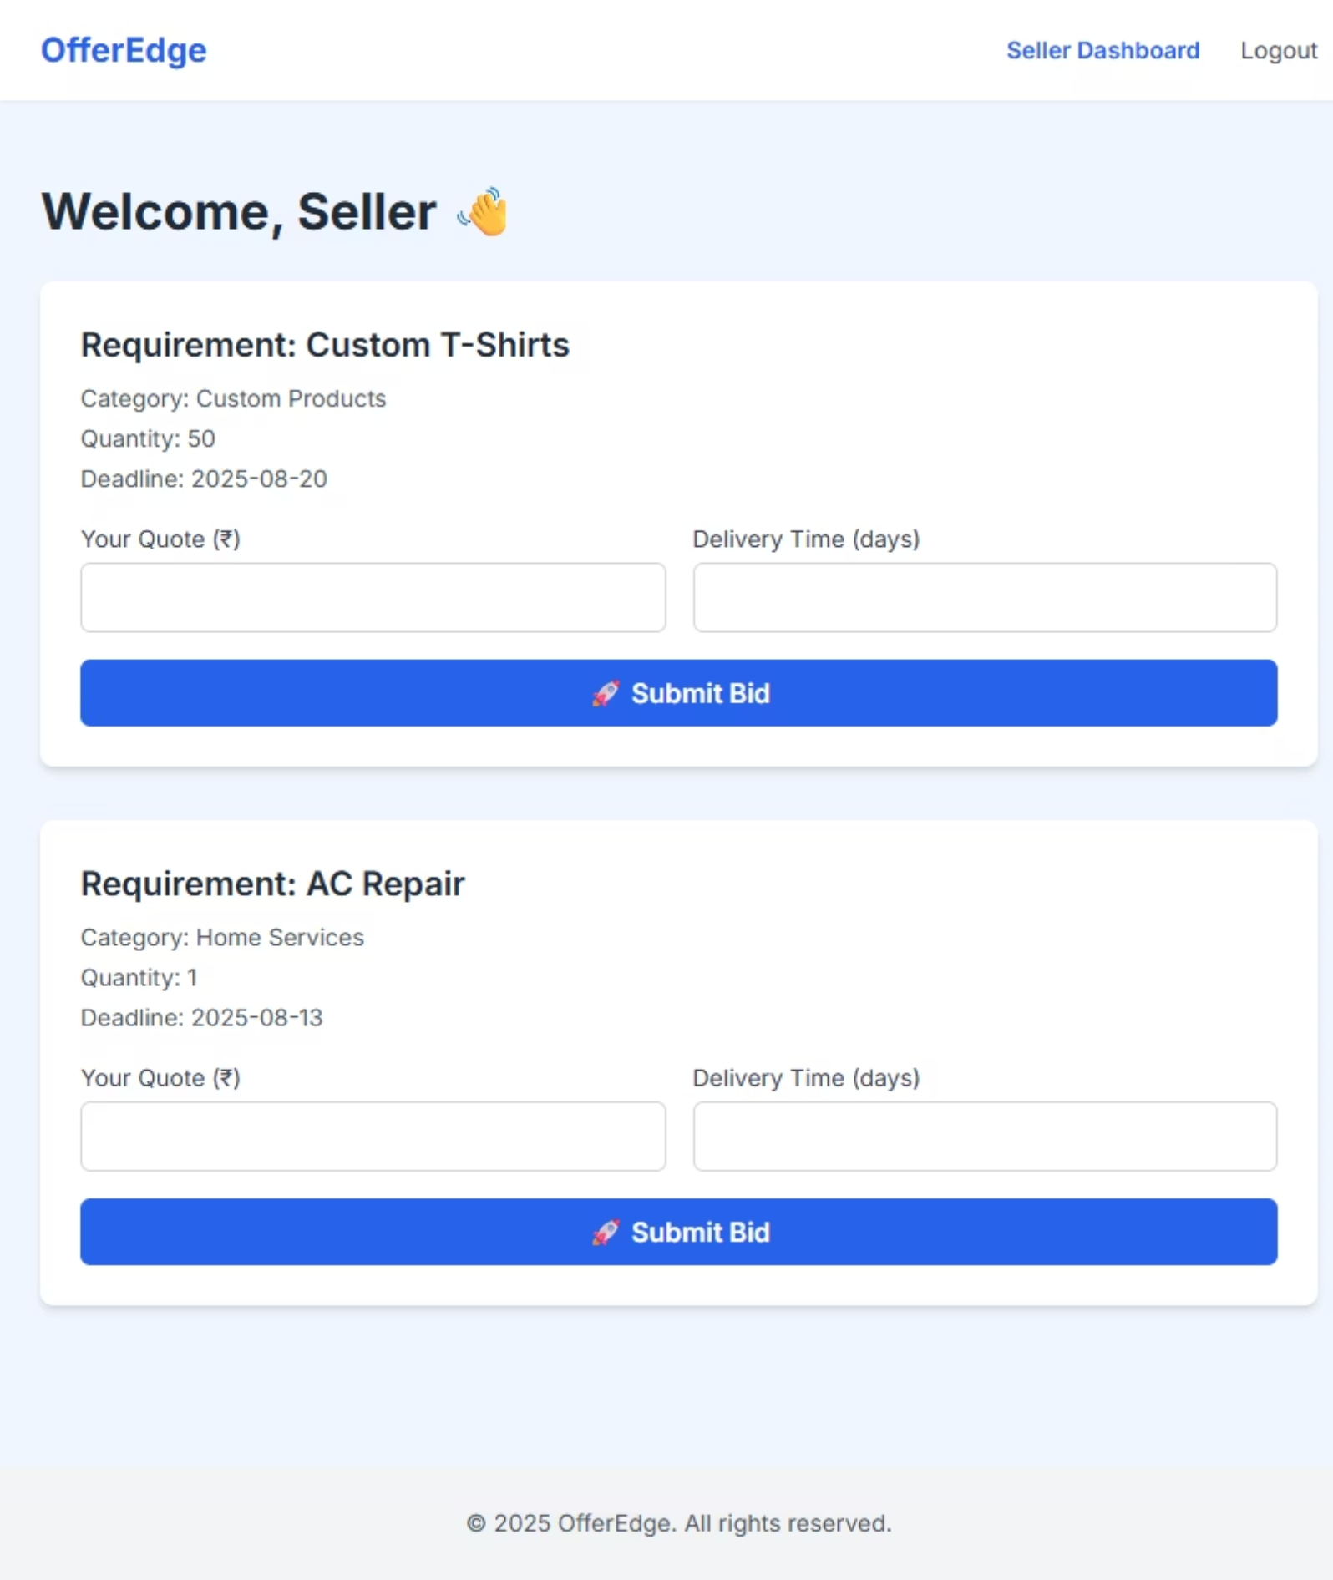

Slide 19

Thank You!

